Slide 1
Intro to Self-Defense
Art - “Solidarity” by T. Osborne

Slide 2
Schedule & Ground Rules
2:00 - 3:00PM - Group Lesson - (Covering a LOT of information)
3:00 - 3:30PM - Group Questions
3:30 - 4:00PM - Open questions / discussion time
(Presenters will be available for
conversation for the full thirty minutes)
Please, no photography or video.
A summary handout will be available after the class.

Slide 3
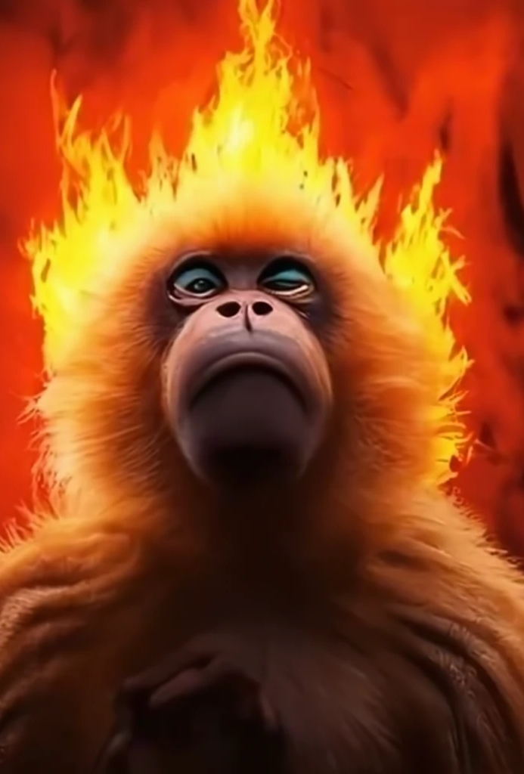
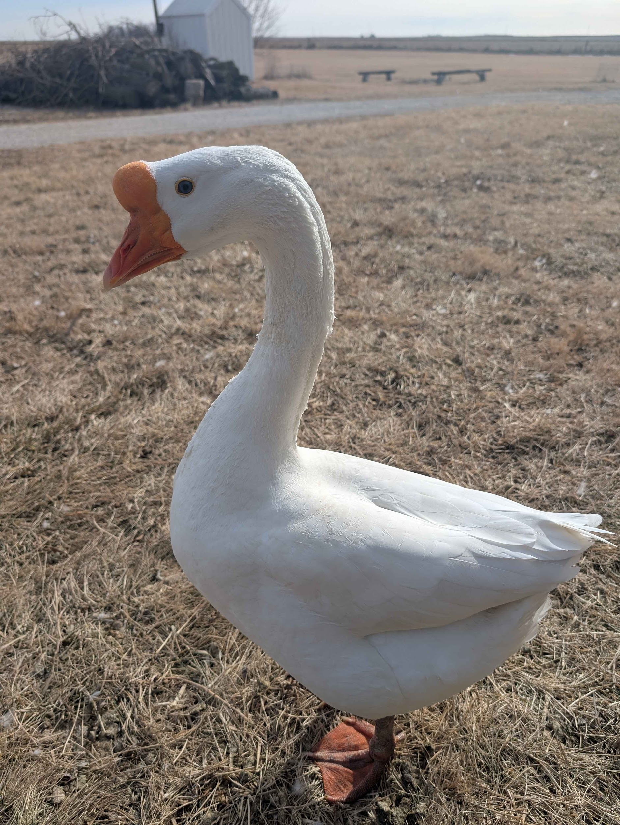
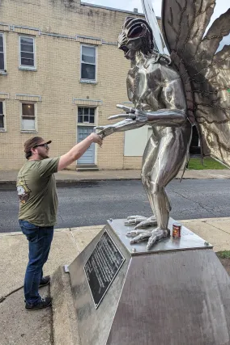
Who are we?
Sean (he/him)
Range Officer / Gunsmith /
Competitive Shooter /
Local Warlord
Survived the DSM Flood of ‘93
Phil (he/him)
Educator / Organizer
Competitive Shooter
Amateur pepper cultivator
Nick (he/they)
Competitive Shooter /
Tech Wizard
Champion road tripper
JB (she/they)
Educator / Range Officer / Competitive Shooter
Has pet a wild songbird
Jordan (he/they)
Competitive Shooter /
Organizer
Once met Mothman

Slide 4
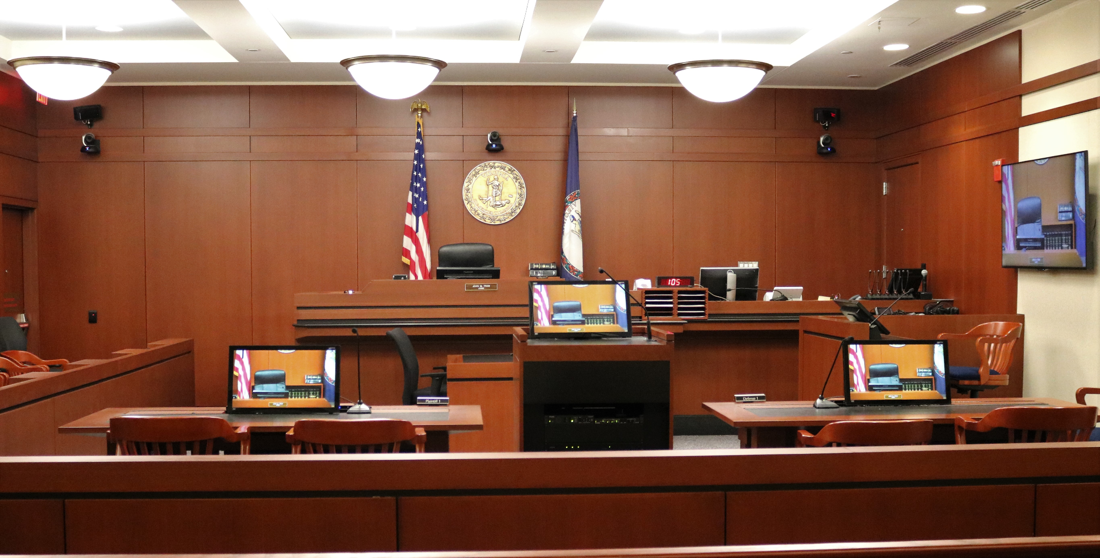
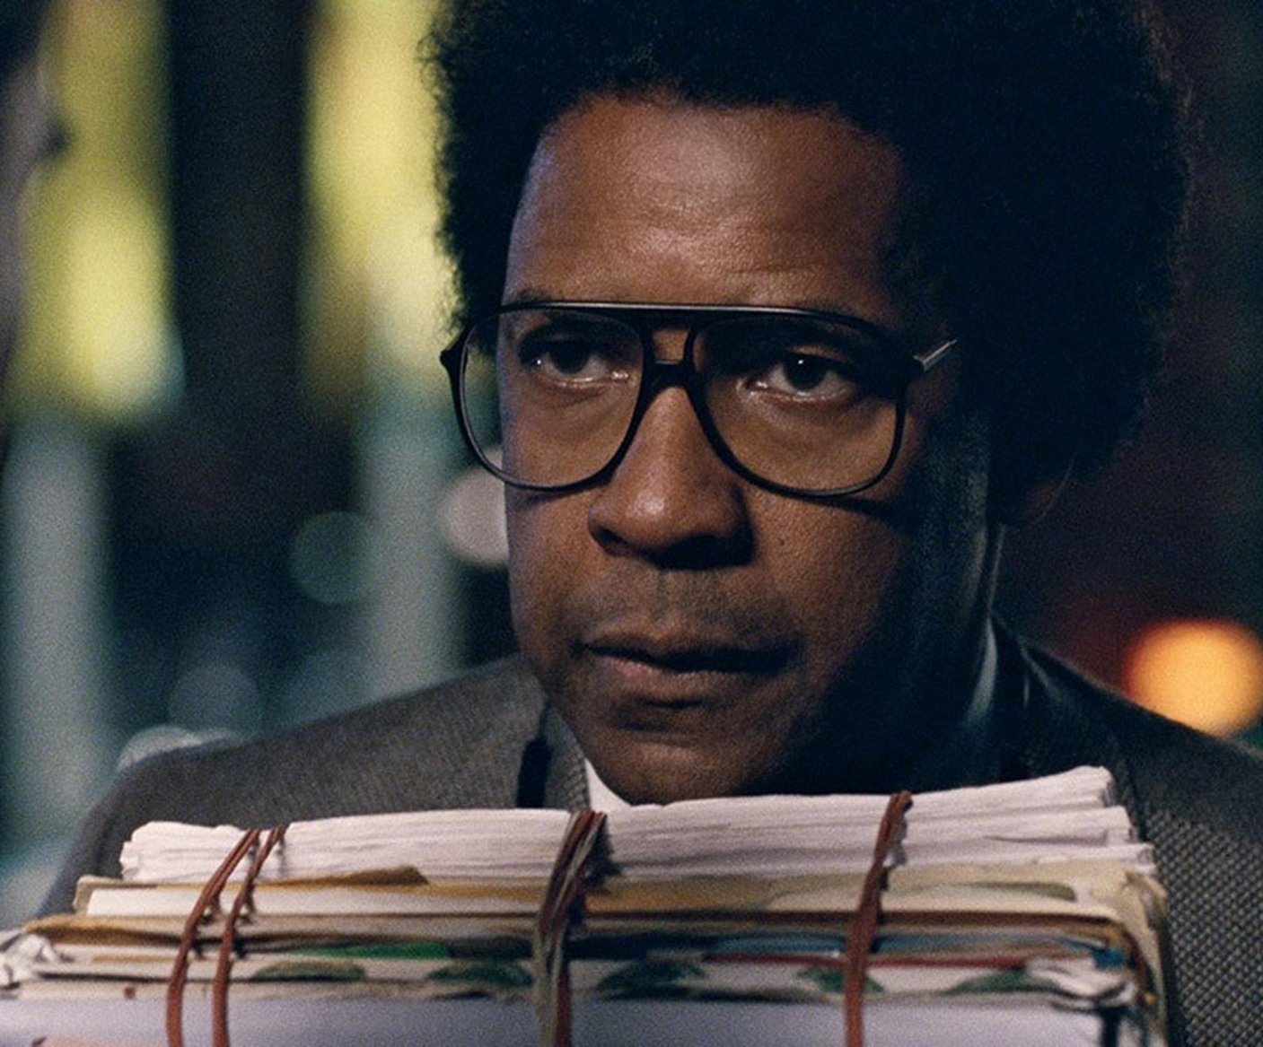
CAVEAT
We are not lawyers.
We cannot give legal advice.
This class is a starting point.
No.
Nope..
Bend and snap! Sorry, no.

Slide 5
Questions we are answering today.
What is self defense?
What are the laws about self defense in Iowa?
What kind of self-defense tools exist?
What self defense tools should I avoid?
When should I consider a firearm for self-defense?
What are the firearms laws in Iowa?
How do I choose a firearm?
How do I legally purchase a firearm?
How do I responsibly own a firearm?
How do I learn how to shoot?
Who can I look to for advice in the future?
What else do I need to know??

Slide 6
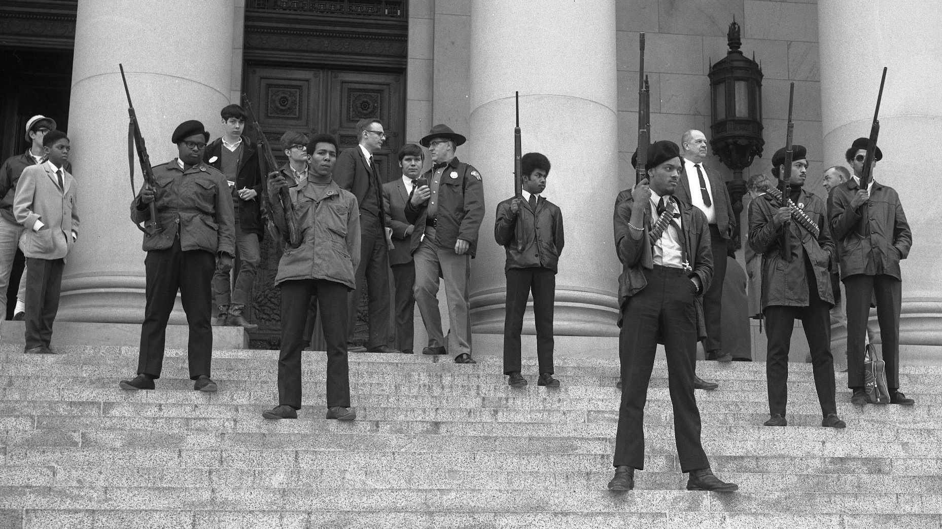
What is self defense?
The use of skills, tools, or any other measures to protect oneself from harm.
The use of proportional amount of force to either disable or incapacitate a threat.
Self defense is a broad continuum. Simply leaving a room can be self defense. So can locking the door, or driving away. We are here today primarily to talk about tools for self defense that are meant to physically disable or incapacitate a person in order to stop them from doing harm in the moment.
The right to self defense is an inherent human right: it can be recognized by law, but is not solely granted by law. However, knowledge of the law is important.

Slide 7
Disable or Incapacitate - what does that mean?
Simply put, to reduce the capacity of another person to harm you.
Create a Barrier
Disrupt Vision
Physically Disable an Attacker
Hide
Leave the Area
Trip or Immobilize
Run Away
Draw Attention
Be Somewhere Else
Summon Aid
Secure Points of Access
Outnumber
Knock Out
Etc…

Slide 8
Self Defense in Iowa Law
Iowa Code § 704.3 and § 704.1 (1)
“A person is justified in the use of reasonable force when the person reasonably believes that such force is necessary to defend oneself or another from any actual or imminent use of unlawful force.
“‘Reasonable force’ means that force and no more which a reasonable person, in like circumstances, would judge to be necessary to prevent an injury or loss of life and can include deadly force if it is reasonable to avoid injury or risk to one’s life or safety or the safety of another, or it is reasonable to believe that such force is necessary to resist a like force or threat.”
Iowa Code § 704.1 (3)
“A person who is not engaged in illegal activity has no duty to retreat from any place where the person is lawfully present before using force as specified in this chapter.”
Iowa Code § 704.6
“The defense of justification is not available to the following: One who is participating in a forcible felony, a riot, or a duel… One who initially provokes the use of force against oneself, with the intent to use such force as an excuse to inflict injury on the assailant.”

Slide 9
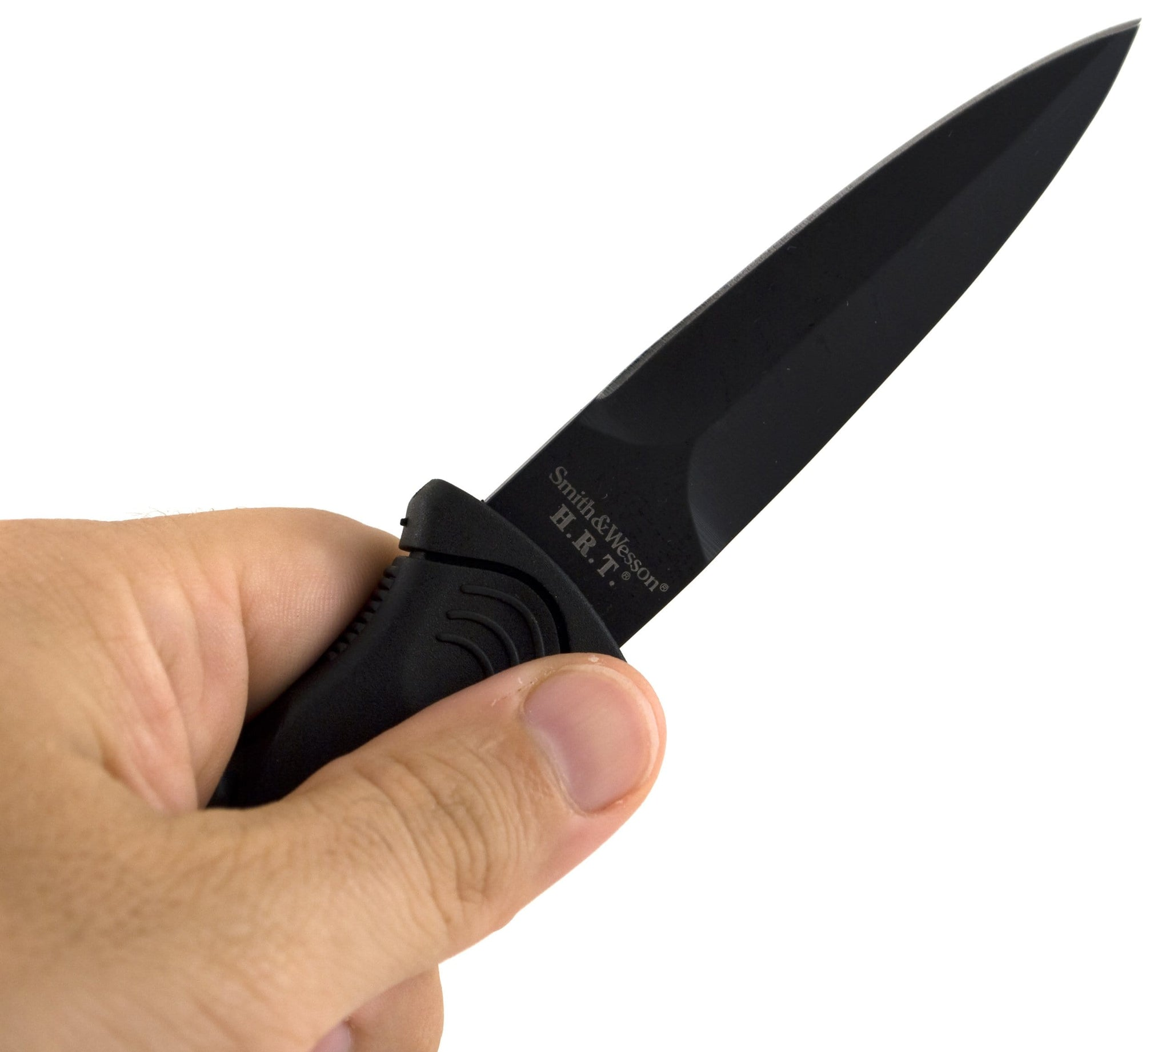
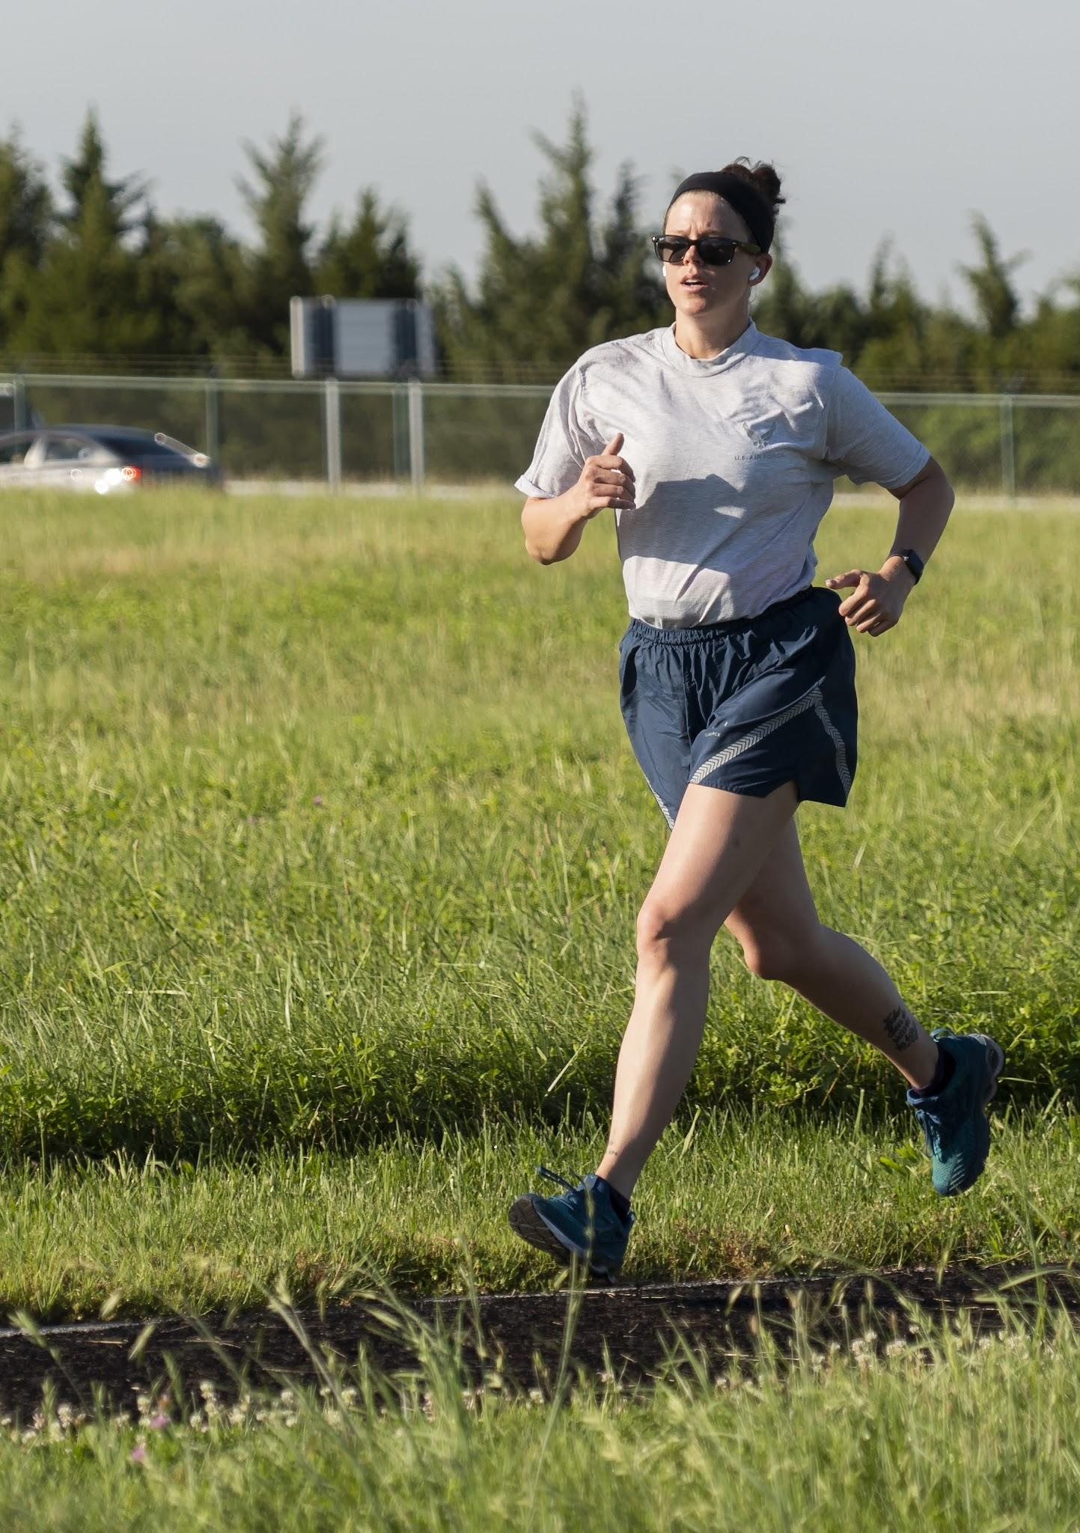
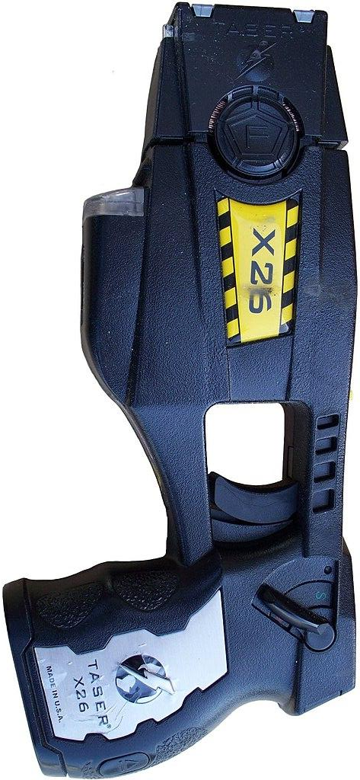
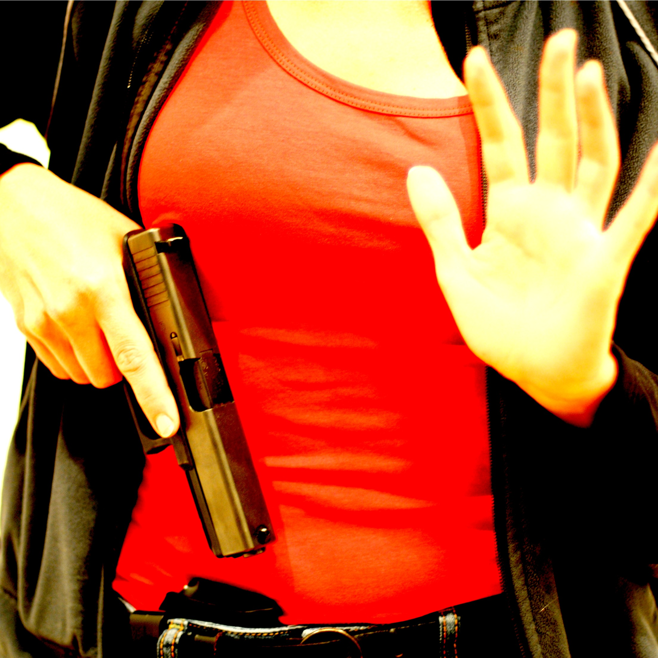
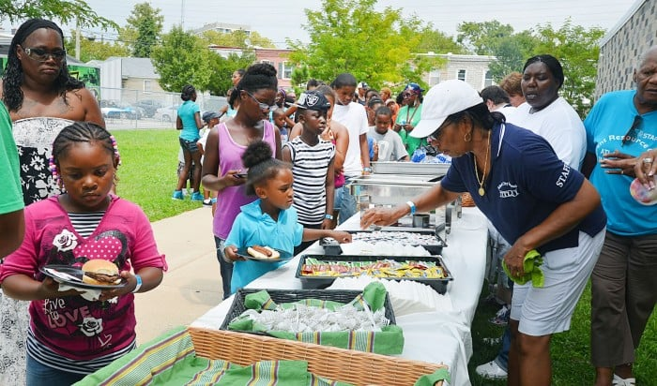
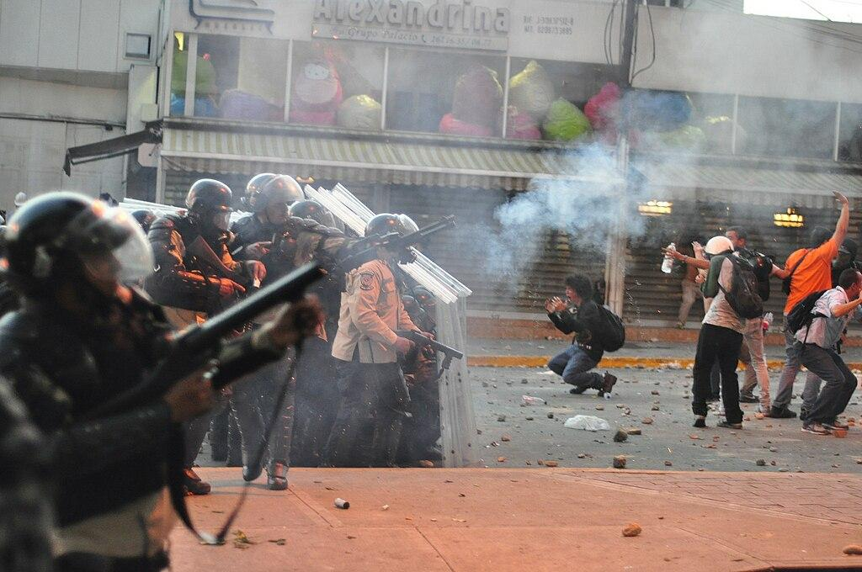
Self defense can be…
“Less Lethal”
Capable of causing severe injury or death in certain circumstances
Nonlethal
Little to no chance of causing severe injury or death
Lethal
Intended to cause severe injury or death

Slide 10
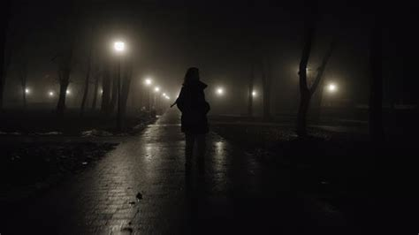
Continuum of Force / Use of Force Continuum
Slurs
Catcalls
Armed Attacker
Stares
Verbal Threats
Street Harassment
Mugging
Multiple Armed Attackers
Child says something rude
Being Followed
Attempted car or home entry
Lesser Reasonable Perception of Risk Greater
Nonverbal
Verbal
Unaided Physical
Less lethal physical
Lethal
Ignoring
Leaving
Watching
Warning
Shouting
Calling for help
Defensive posture
Pushing past
Pepper spray
Physical holds
Striking
Impact weapon
Firearm use

Slide 11
Your Threat Model May Vary
Slurs
Armed Attacker
Catcalls
Verbal Threats
?!?
Stares
Street Harassment
Mugging
Multiple Armed Attackers
Child says something rude
Being Followed
Attempted car or home entry
!?!
Lesser Reasonable Perception of Risk Greater
Nonverbal
Verbal
Unaided Physical
Less lethal physical
Lethal
Ultimately, you are the one who has to assess your own life, your own risks, and the degrees to which you are comfortable with force. What concerns you? What are your circumstances? What is your commute? Who do you protect?

Slide 12
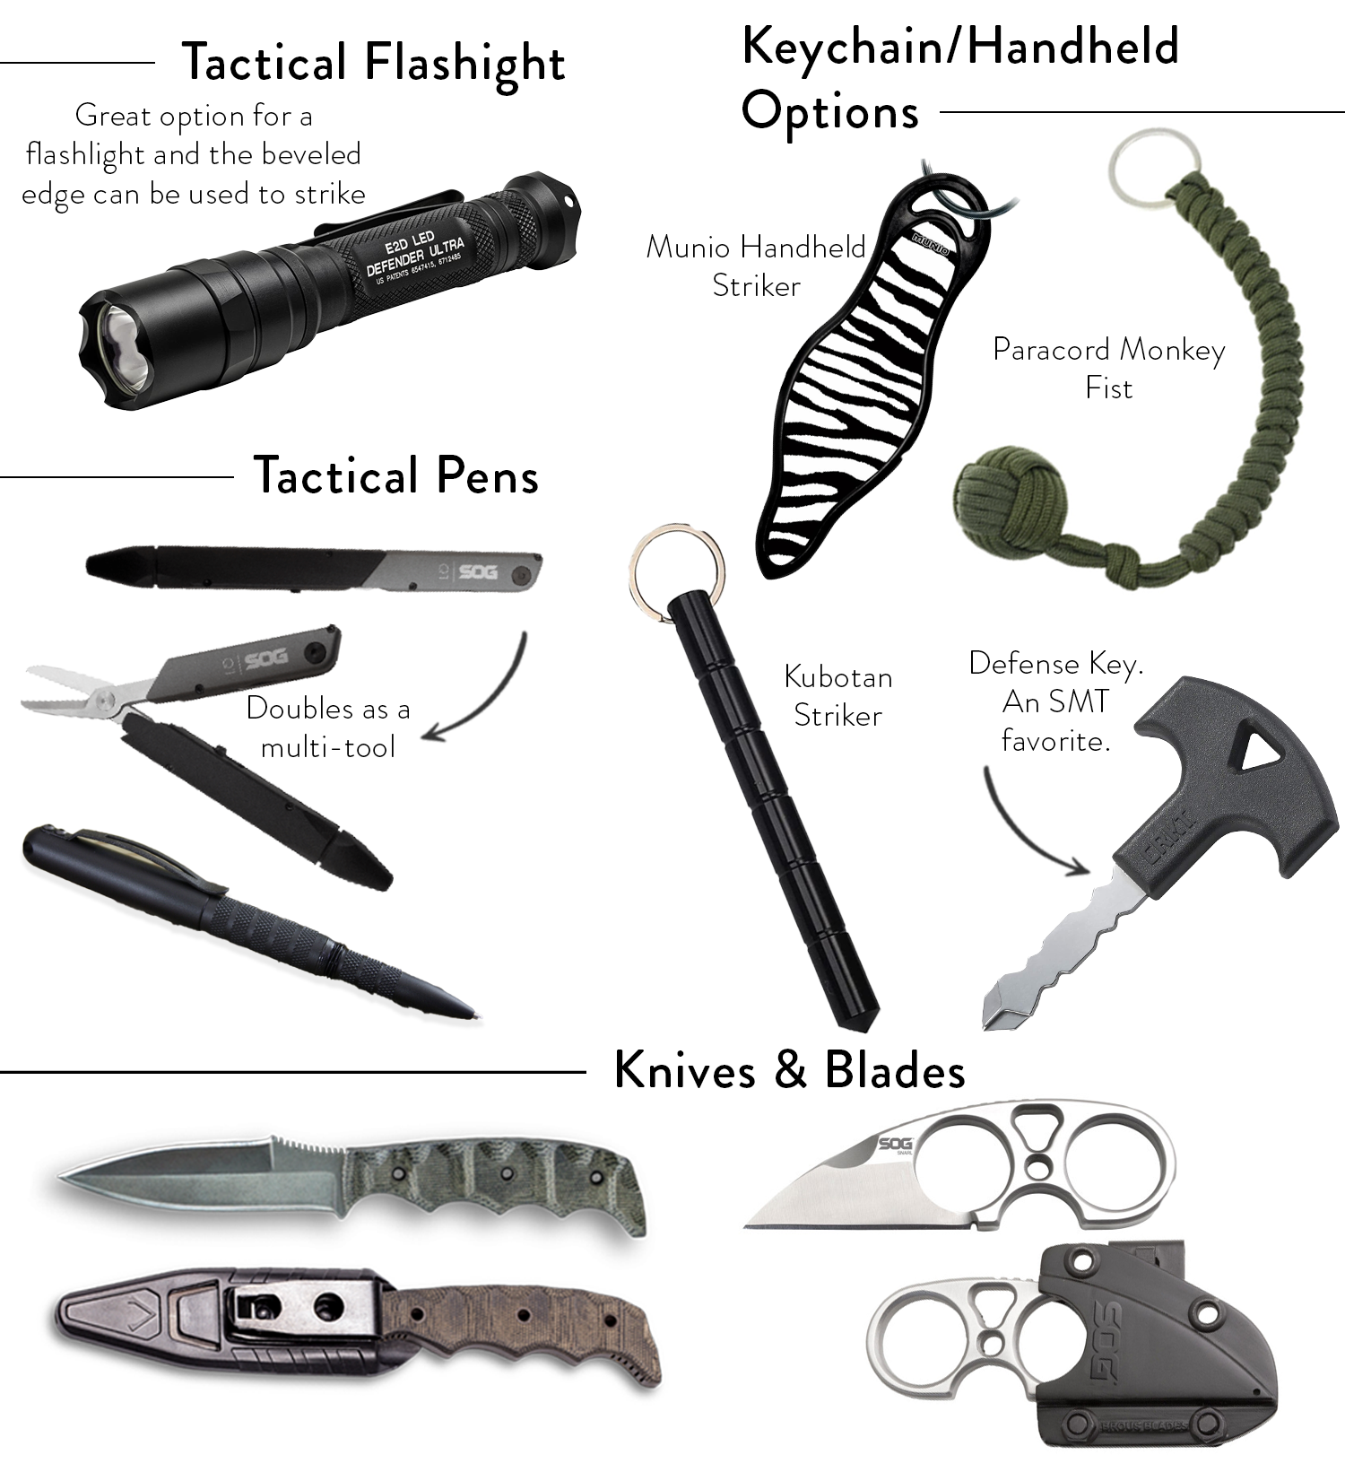
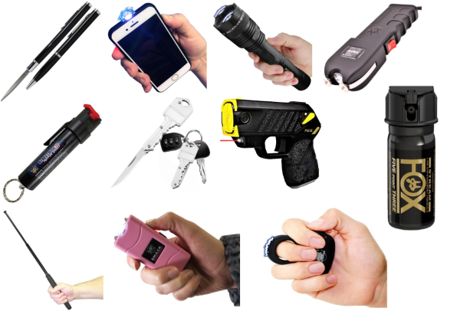
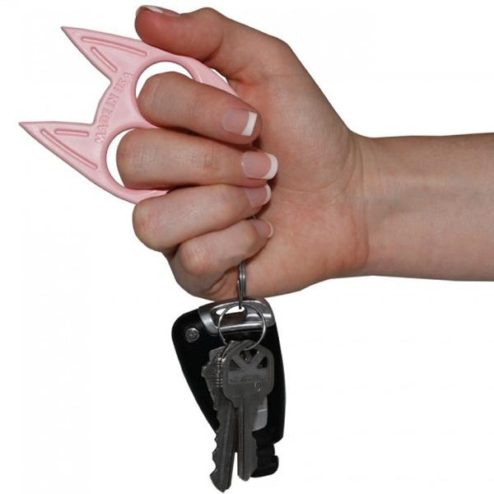
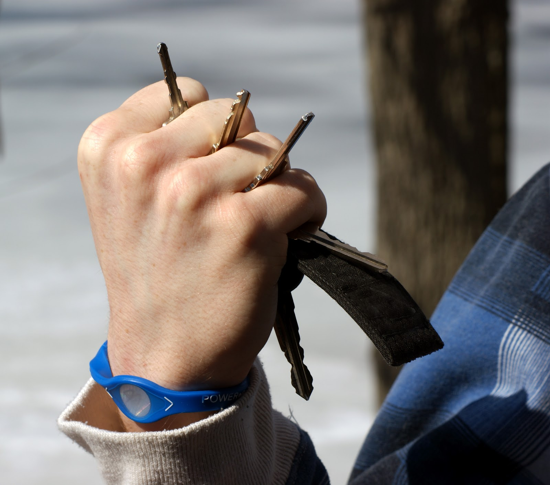
Which of these tools have you seen? …and which of these tools are recommended for self defense?

Slide 13
Pain compliance is severely inconsistent.

Slide 14
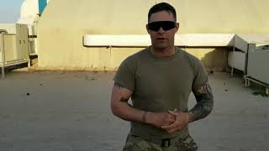
Why not knives?
“The loser of a knife fight dies on the street.
The winner dies in the ambulance.”

Slide 15
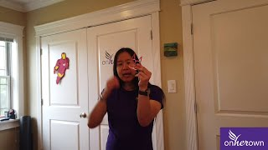
Why not cat punchers / keys / knuckles?
Annette Evans - https://onherown.life

Slide 16
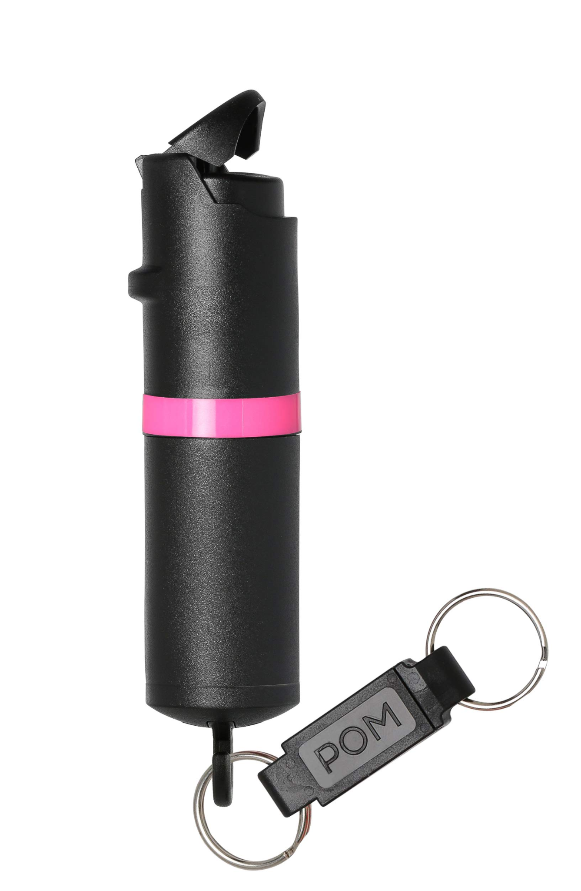
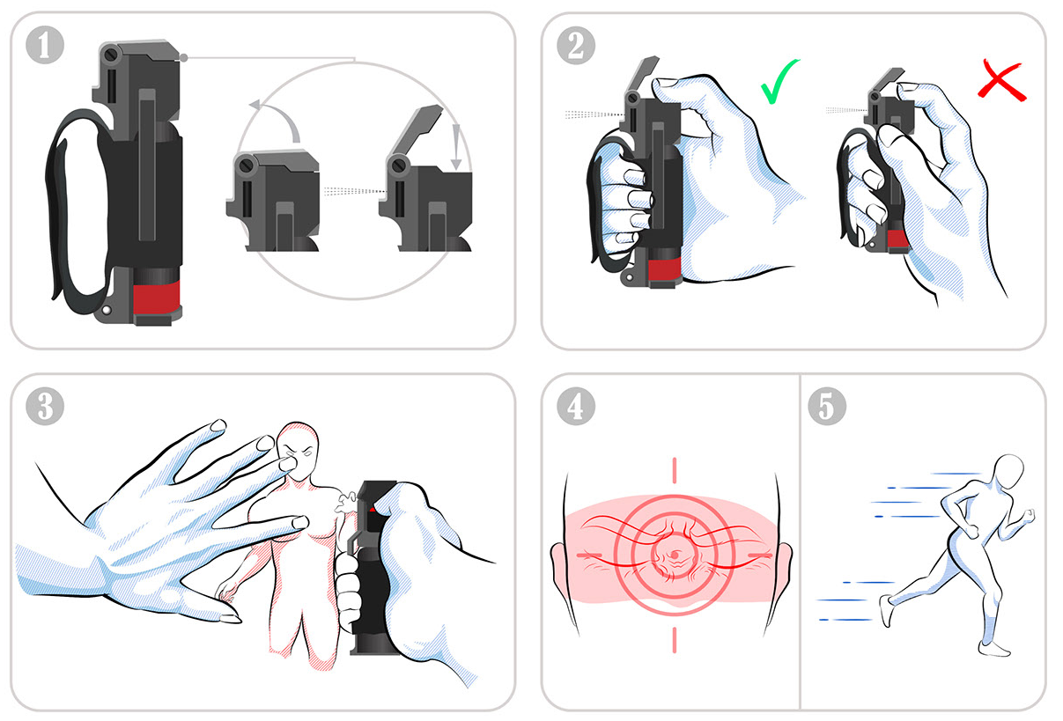
Pepper spray - the basics
Nonlethal - little to no chance of causing severe injury or death
Irritates eyes, nose, throat, mucous membranes, leading to difficulty seeing and breathing.
Not guaranteed to stop a determined attacker, nor someone using substances.
After using pepper spray, the next step is to run away. Leave the scene. Call police if safe to do so.
We recommend a flip top safety and a liquid spray. Foam and gel are not advised.
Pepper spray is largely unregulated in Iowa.
Recommended: Fox or Pom sprays

Slide 17
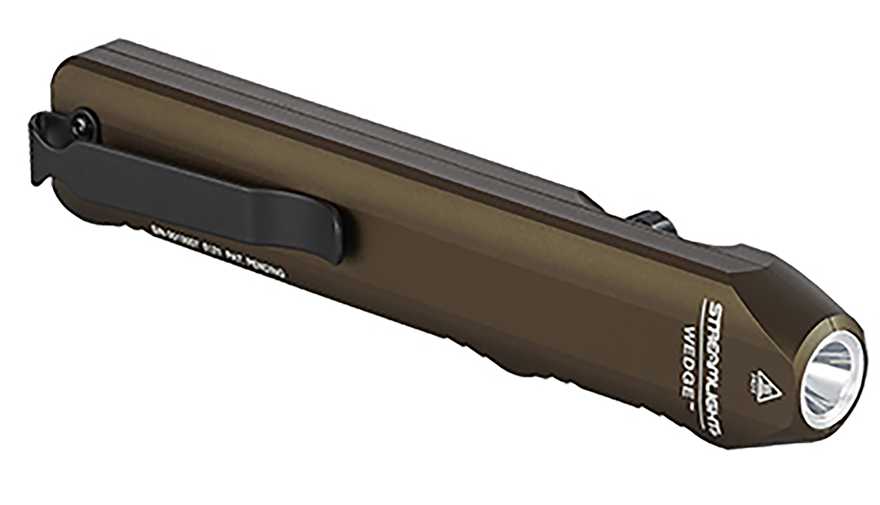
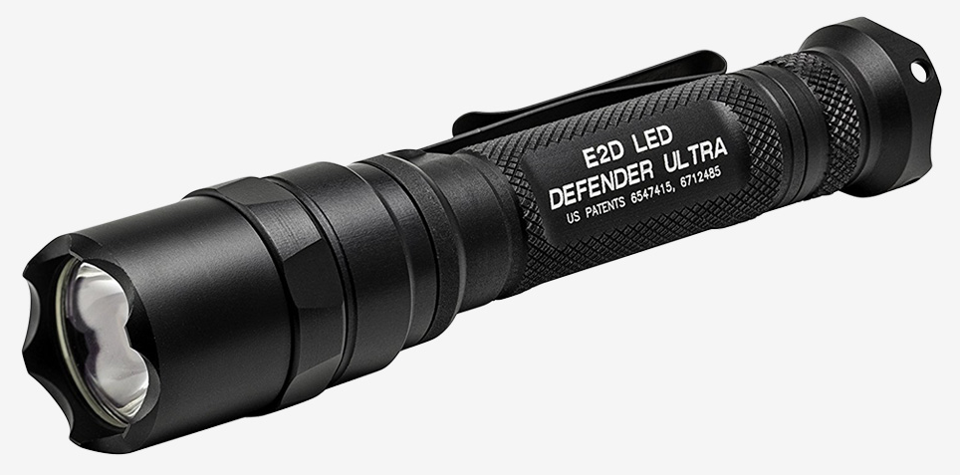
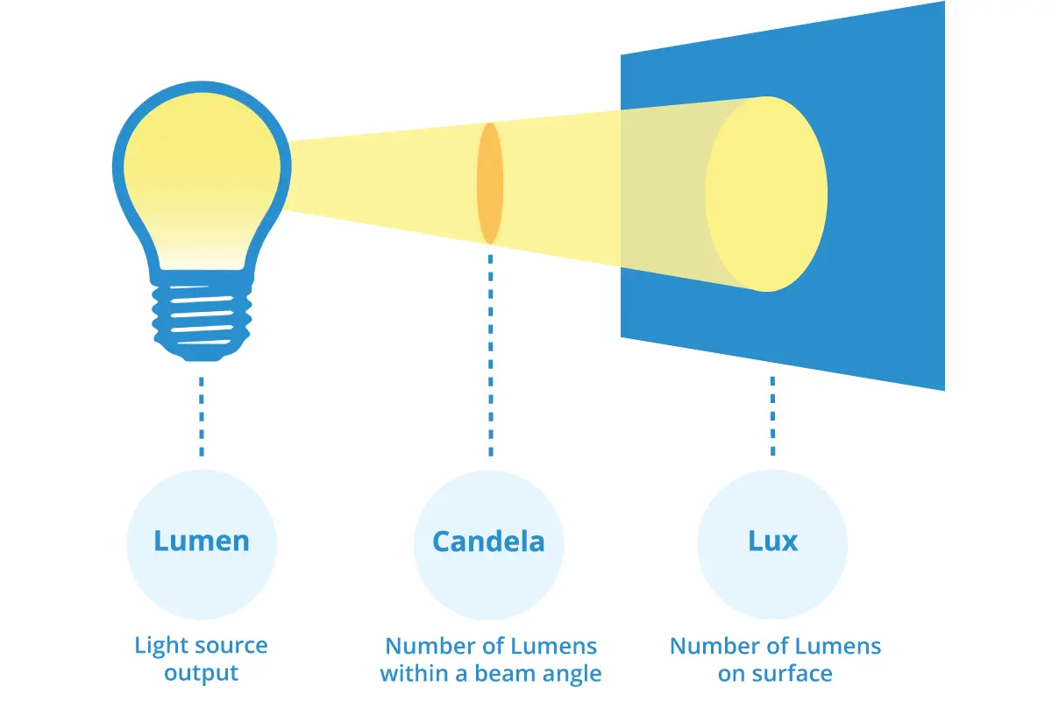
Flashlight - the basics
Nonlethal - a flashlight is a self-defense tool, and only very rarely a weapon.
The primary use of a defensive flashlight is for your own information: a quick scan of a dark alleyway, the back seat of your car, or a parking lot.
If needed, a flashlight can temporarily disrupt the vision of an attacker, giving you time to run away.
A small flashlight that you’ll always have on you is best.
Look for:
High lumens (brightness)
High candela (throw distance)
Good battery life
Recommended: Streamlight Wedge or Wedge XT, Surefire

Slide 18
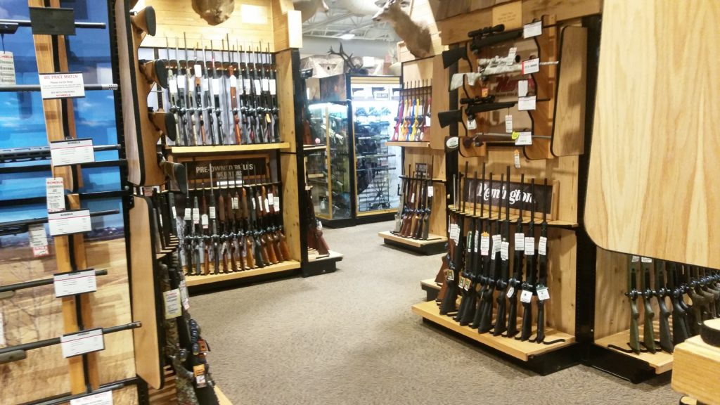
When should I consider a firearm?
Am I willing to spend time learning and practicing?
Can I commit to store it safely?
Do I have a safe storage plan if I experience a mental health crisis or experience SI?
Yes
Yes
Yes
No
No
No
Do I feel that I need to hide my decision to purchase a firearm from people I live with?
A firearm is likely not for you.
Yes
No
No
Am I ready and willing to educate myself about the laws of firearms use and defense?
No
No
Yes
A firearm might be for you.
Am I prepared or willing to prepare for the consequences of using a firearm defensively?
Am I willing to hold myself to high standards of good conduct, patience, and calm?
Yes
Yes

Slide 19
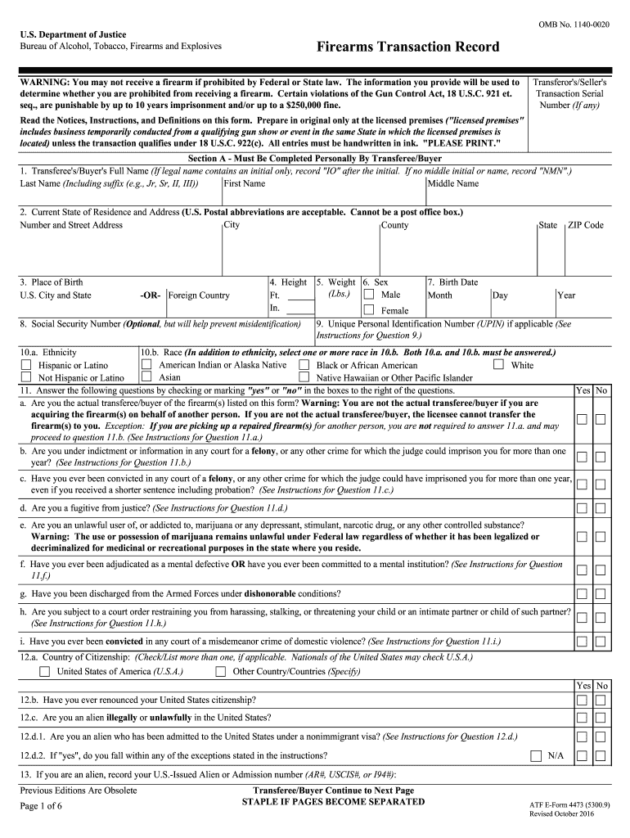
How do I purchase a firearm legally?
Note: Laws for purchase of firearms are non-negotiable. Do not get yourself in trouble by lying on federal paperwork. It is not worth it.
To legally purchase a firearm in Iowa, you must
Be 18 years of age (long gun)
Be 21 years of age (handgun)
Be a citizen of the United States OR
Be a legal or lawful noncitizen resident
Not be a felon
Not be an unlawful user of a controlled substance
Not have a domestic violence conviction
Not have been dishonorably discharged from an armed service
Not be purchasing the firearm on behalf of someone else (straw purchases are illegal)
Not have intent to use the firearm in the commission of a felony
Form 4473

Slide 20
Things to keep in mind for the 4473
Your presented ID documents must match what you fill out on your paperwork.
Legal name, current address on DL, and, unfortunately, gender marker.
This can be a barrier to access.
Please remember, it is never a good idea to record legally false information on firearms paperwork. Legal names (deadnames in some cases) are a legal necessity as opposed to real / chosen / lived names.
Consider bringing a friend for moral support, or contact an instructor to come with you.
No federally protected class is inherently a barrier to firearms ownership. If you otherwise qualify, you maintain your rights to self defense and firearms ownership.

Slide 21
How do I choose a firearm?
There are two primary considerations:
Use Case
Budget
Why do you need it, and what restrictions are you under?
How much can you responsibly spend?

Slide 22
What threats am I concerned about?
What is my living situation?
How much time I can spend on training?
Use Case
What does my daily environment look like?
What are my physical abilities or challenges?
What legal restrictions or advantages do I have?
What are my safe storage options?

Slide 23
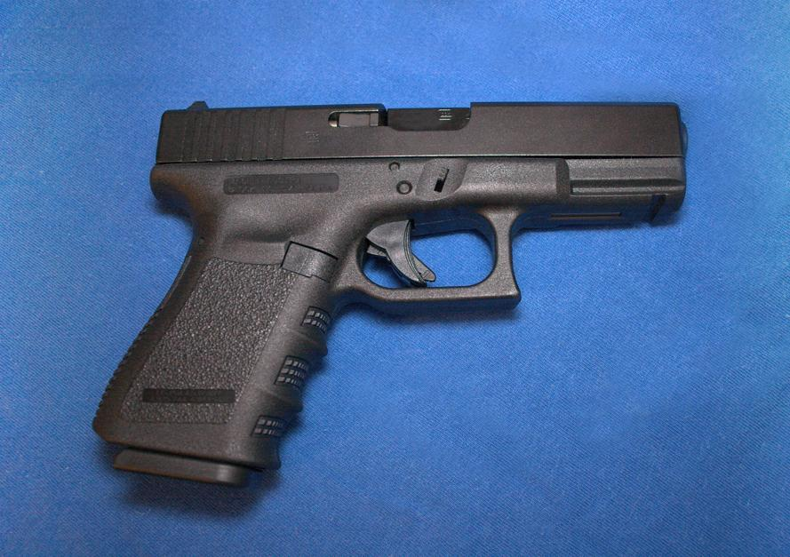
The standard, baseline rec
Glock 19 or Equiv. - $300-$600
50+ rounds defensive 9mm - $50+
200+ rounds practice 9mm - $80+
Safe ccw holster - $40-$200
Four magazines $50-$100
TOTAL: $520 - $1,000+
Budget
This is not one size fits all. No recommendation can be.
Golden Rules for New Firearms Owners
Start with an affordable, reliable firearm you are comfortable shooting.
If you have extra money, spend it on ammunition and training before buying new guns or accessories.
Only spend money on accessories, modifications, new firearms etc. once you are proficient and comfortable with your first firearm.

Slide 24
Reliability
Shootability
Concealability
Will this firearm reliably fire, cycle, and otherwise function on demand? Is it mechanically accurate?
Am I physically able to comfortably fire this firearm with sufficient accuracy on demand?
If I intend to carry this firearm concealed, can I do so comfortable and consistently?
Considerations
Size
Caliber
Action
Ease of training
Considerations
Size
Shape of firearm
Holster choice
Dress style
Considerations
Ease of maintenance
Ammunition choice (type of cartridge)

Slide 25
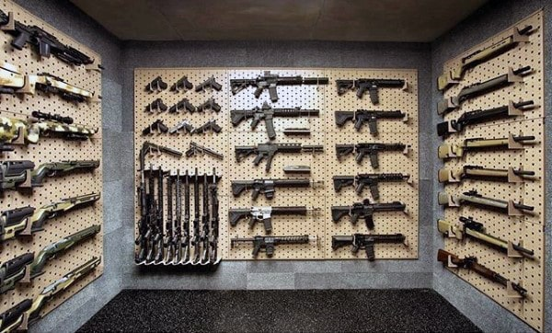
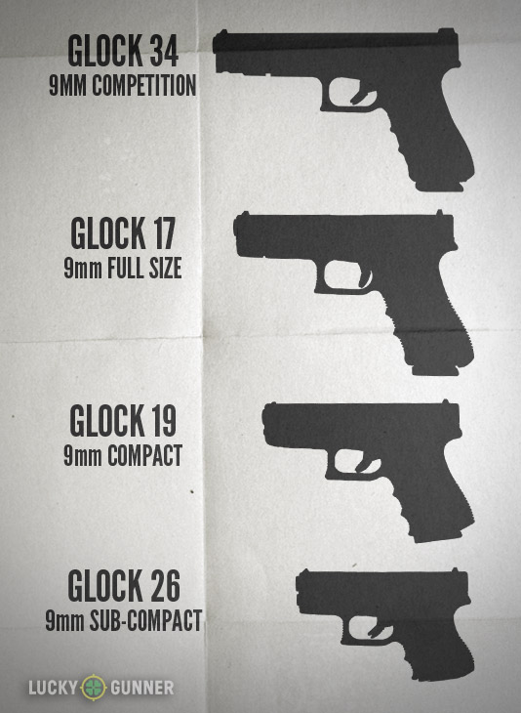
CONCEALABILITY
SHOOTABILITY

Slide 26
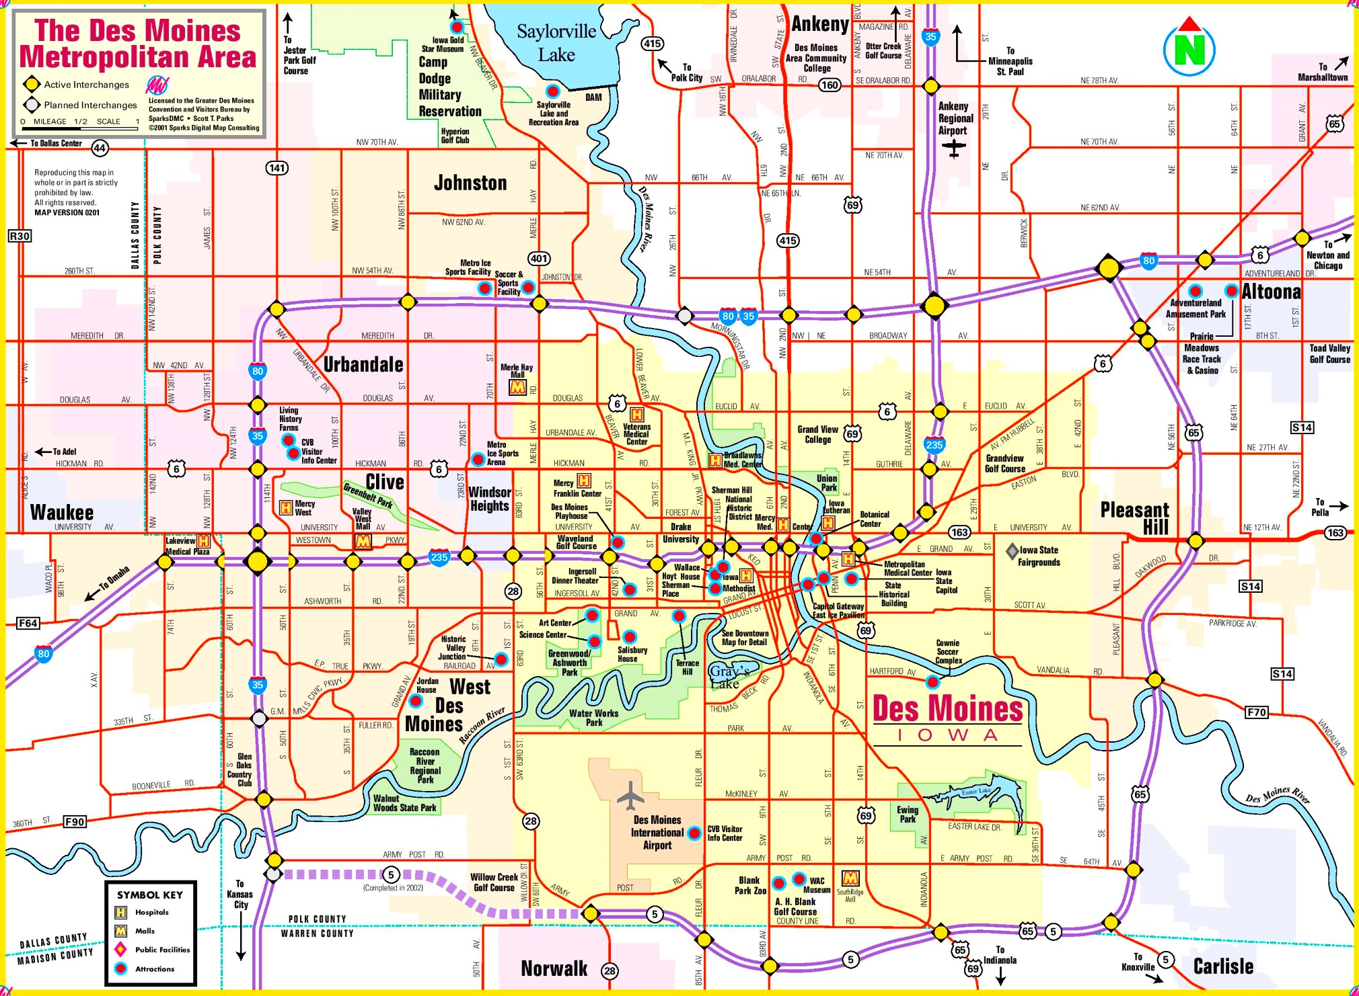
Where in the DSM Metro can I purchase a firearm?

Slide 27
Can I buy a gun online?
Yes, but it has to be shipped to an FFL (Federal Firearms License) holder.
Most commonly, this will be a gunshop
You will need to provide the information for your FFL of choice at the time of purchase
Most FFLs also require you to notify them prior to their receipt of the firearm.
The FFL will perform the required background check and 4473
FFLs will generally charge a transfer fee to complete the transaction.
The serialized component of a firearm is the firearm as far as the government is concerned
This means that other parts and components that do not include a serialized component generally can be shipped to your home.

Slide 28
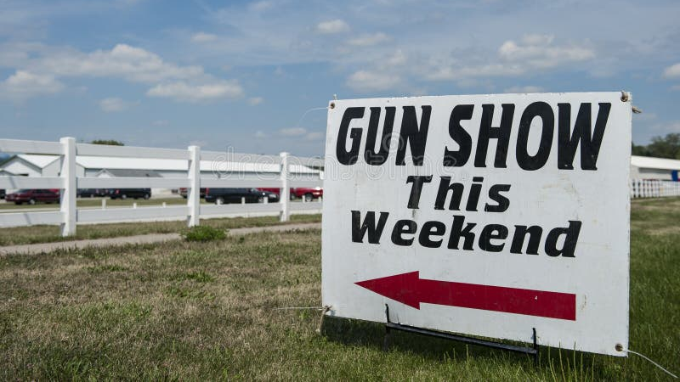
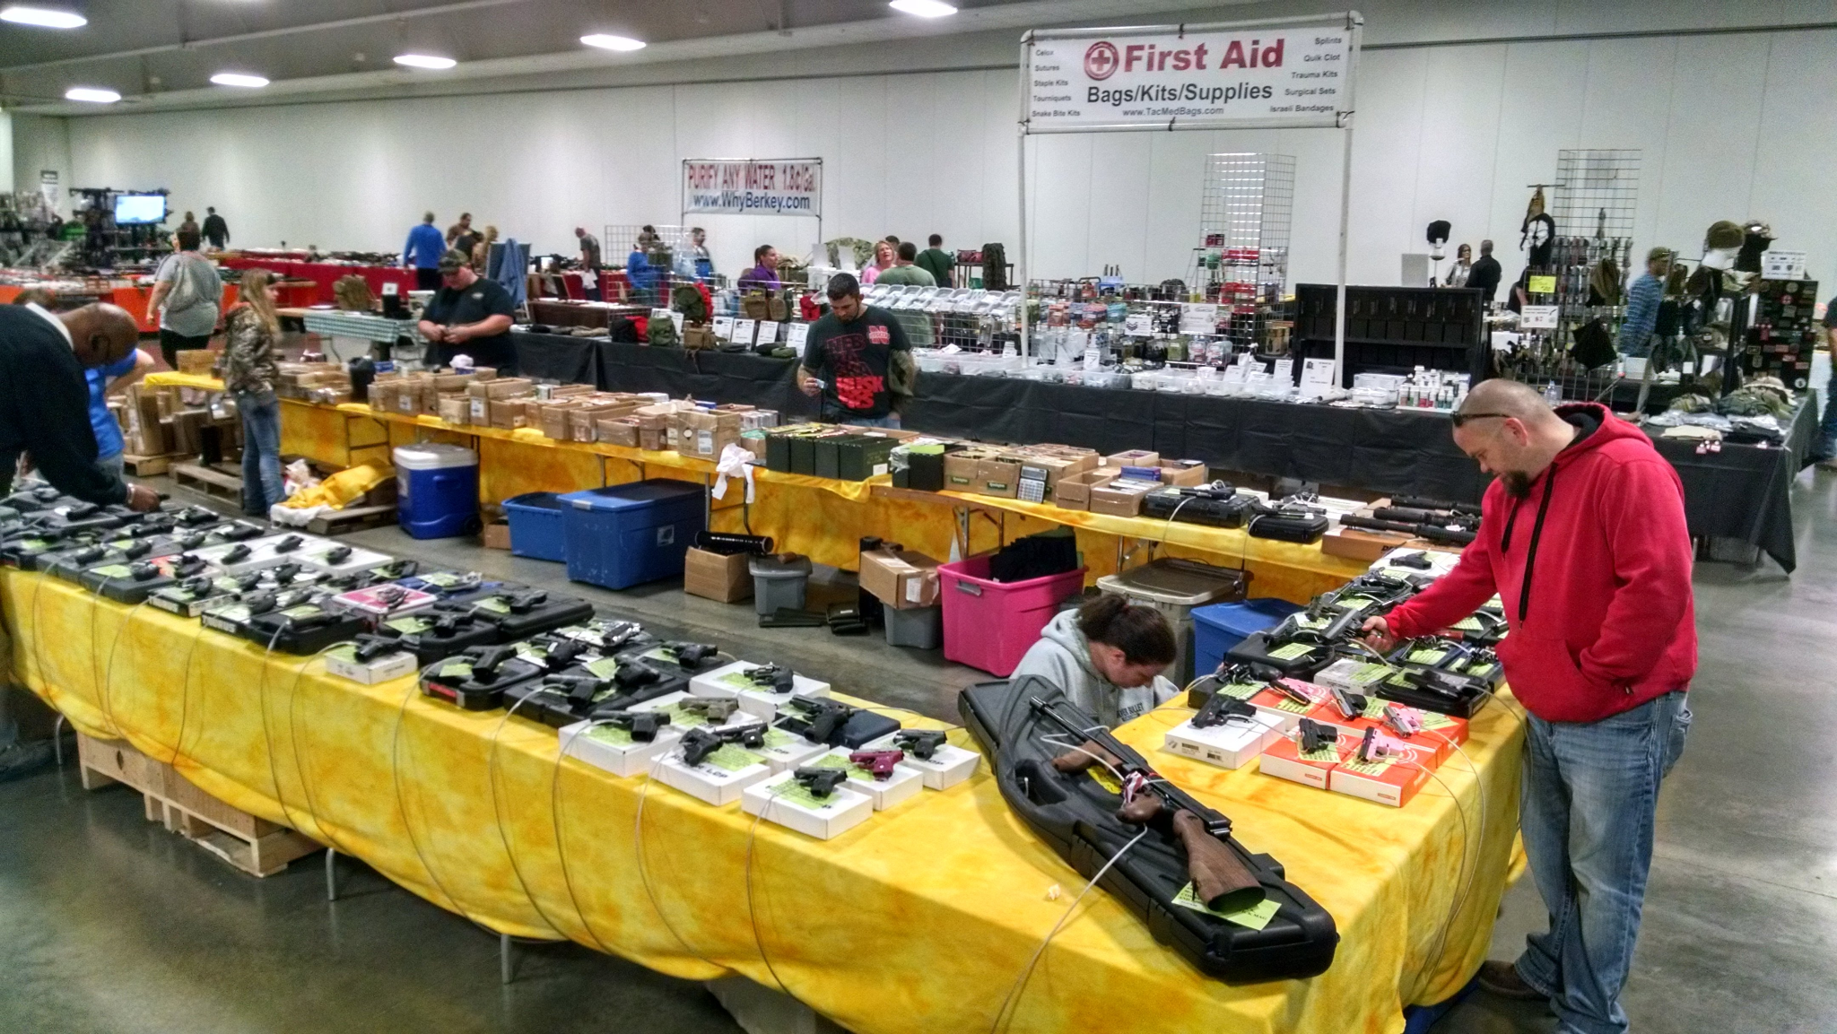
Can I buy a gun at a gun show?
Yes, but that is probably not the best move for a first firearm.
Gun shows feature a blend of private sales and FFL holders selling a selection of their merchandise
Good deals can be found, but it can be very difficult to discern what is a fair price
It can also be difficult for people new to guns to assess the condition of used firearms
Some people may find the crowd and certain vendors at gun shows to be intimidating
Going with a knowledgeable friend or contact can make up for many of these issues.

Slide 29
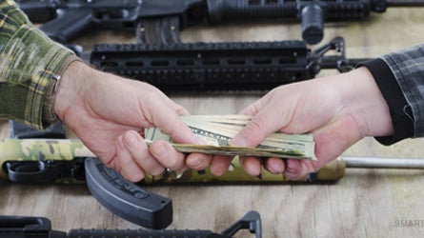
What about private sales (buying directly from another private individual not as a part of a business)?
Private sales are permitted in Iowa, but there are many reasons to be cautious as a new firearm owner.
Private sellers are not required to perform background checks.
However, private sellers can be held liable for selling to a prohibited person or if that sale precedes the commission of a crime.
Previous caveats apply: it can be difficult for someone new to firearms to have the appropriate knowledge of use, maintenance and law to appropriately participate in private sale
As with gun shows, advice from a knowledgeable person can help to make up for the difficulties in navigating private sales
See Iowa Code § 724 for comprehensive weapons laws in the state.

Slide 30
How do I responsibly own a firearm?
Safe Storage
Safe Handling
Safe Mindset
Regular Practice
I will secure my firearm in a secure, locked place accessible only to myself.
I will ensure that I maintain sole custody of the means of access to my firearm and ammunition.
I will openly discuss safety rules and my safe storage choices with people in my home.
I will treat all firearms as though they are loaded until I have verified otherwise.
I will never aim a loaded or unverified firearm at anything I do not intend to shoot.
I will keep my finger off the trigger at all times except when ready to fire.
I take responsibility for the trajectory of every shot I fire.
I know that a firearm is not a totem.
A firearm is a weapon, it is a tool, and it is a responsibility.
A firearm is not a sign of strength or of weakness.
I am not a sheepdog. I am not an avenger. I am a citizen in community.
I will commit to practicing regularly.
I will commit to seeking additional training.
I will commit to self-improvement.
I will commit to practicing related skills.
I will seek out guidance and advice.

Slide 31
How do I responsibly own a firearm (pt. II)?
A FIREARM IS ONE PART OF THE LARGER PICTURE
CARDIO
COMMUNITY
FIRST AID
To the degree that you are able, please work to maintain your health. Every physical skill suffers under stress.
Especially shooting.
We are all in this together. All of us.
Find your people. Expand your sense of who your people are. Talk to your neighbors. Work together. “We protect us” is more than a motto.
All for each other, and none above.
If you’re training how to put holes in people, you need to know how to plug them.
First Aid, CPR/AED and Stop the Bleed trainings are readily accessible and vitally useful.

Slide 32
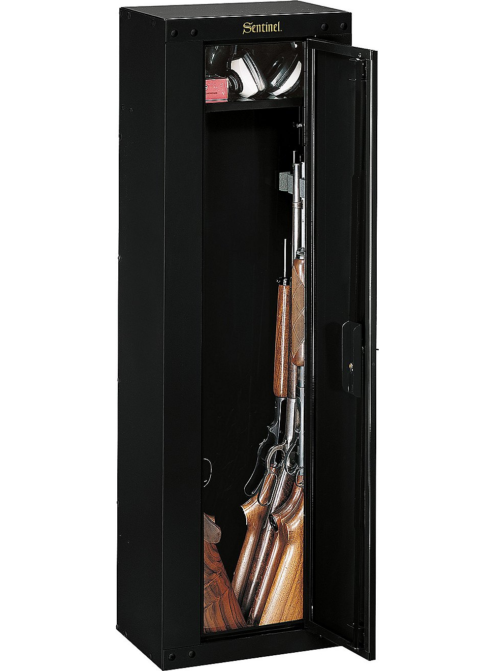
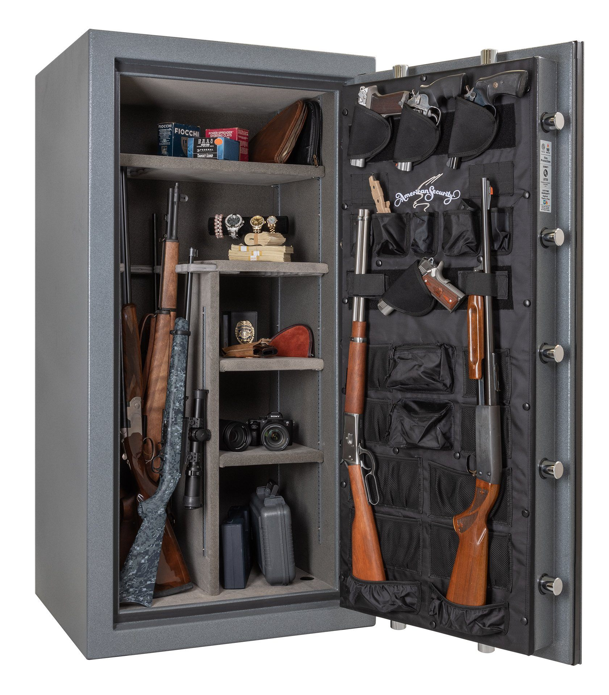
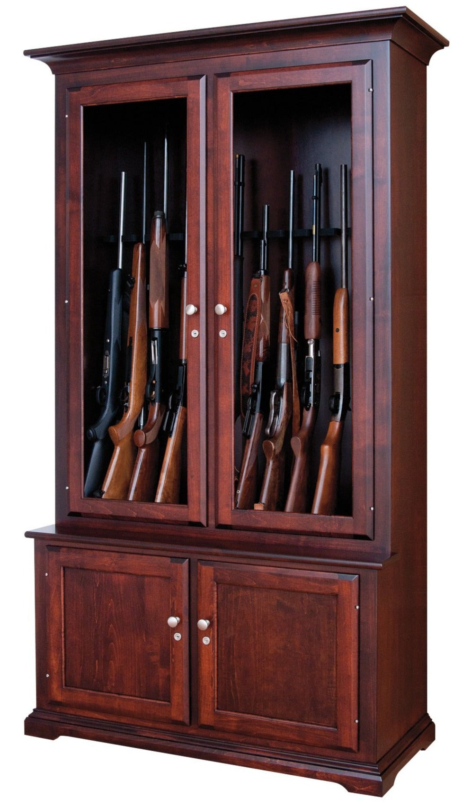
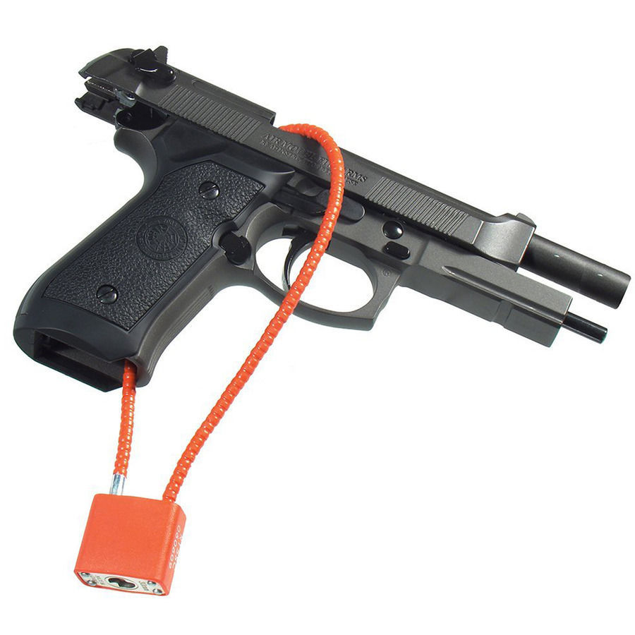
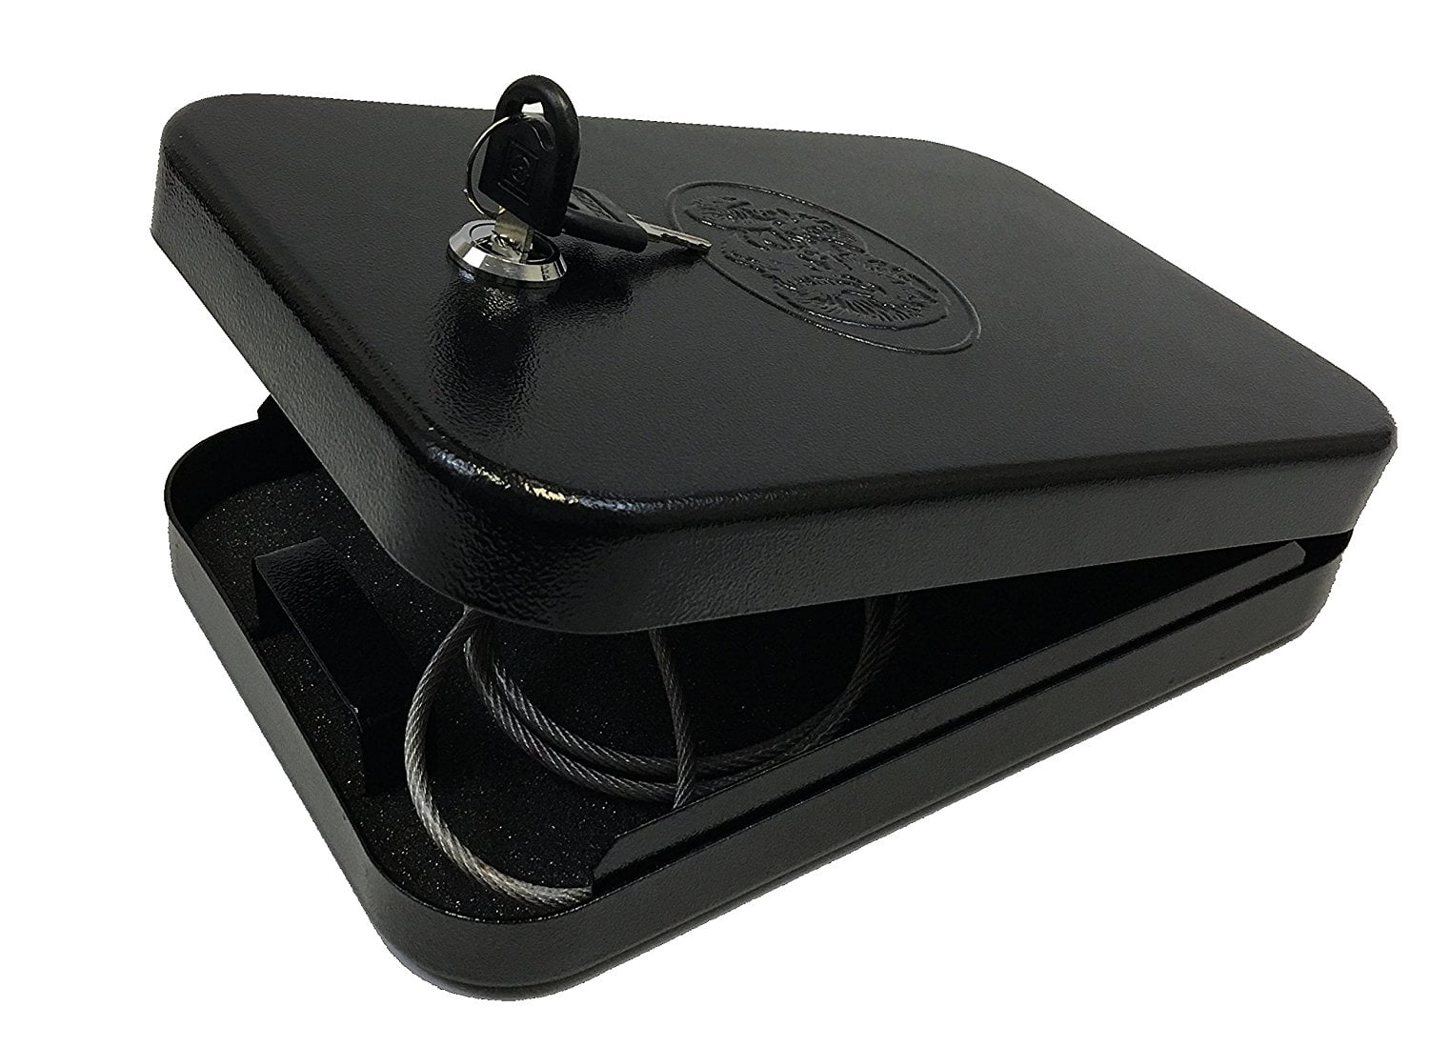
How do I safely store a firearm?
-Trigger lock
-Glassfront
Cabinet
-Metal gun cabinet
-Full-Size Gun Safe
++Bolted to foundation
-Lockbox
LEAST SECURE - - - - - - - - - - - - - - - - MOST SECURE
*”Secure” here meaning “how difficult is it for a person to casually access a functional firearm stored using this method.” All pictured methods vary widely.

Slide 33
How do I safely store a firearm? (pt. 2)
What are your specific storage concerns?
Children in Home
Theft Prevention
Personal Safety / Mental Health
Ammunition stored and locked separately
Functional locks (trigger cables) helpful
Keyed locks, keys secure and secret.
Heavy safe ideal
Bolted to foundation / supports / floor / furniture
Combination lock preferred
Ammunition stored and locked separately
Keyed locks instead of combinations or biometric access (able to give keys to trusted person).

Slide 34
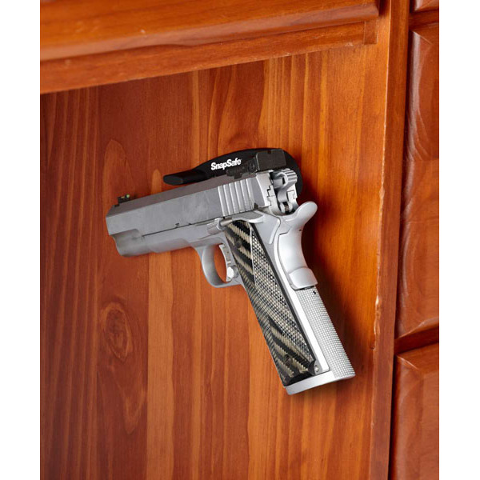
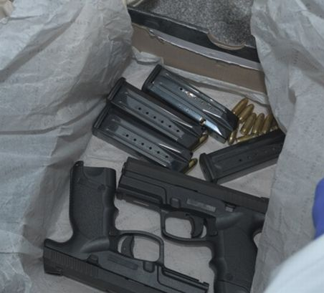
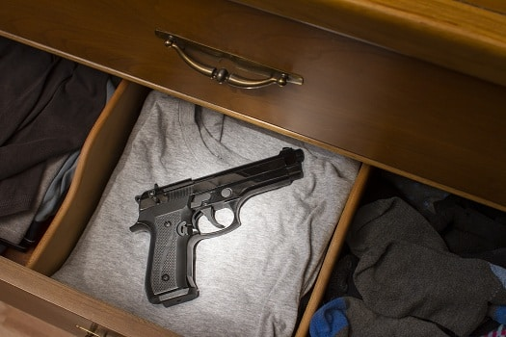
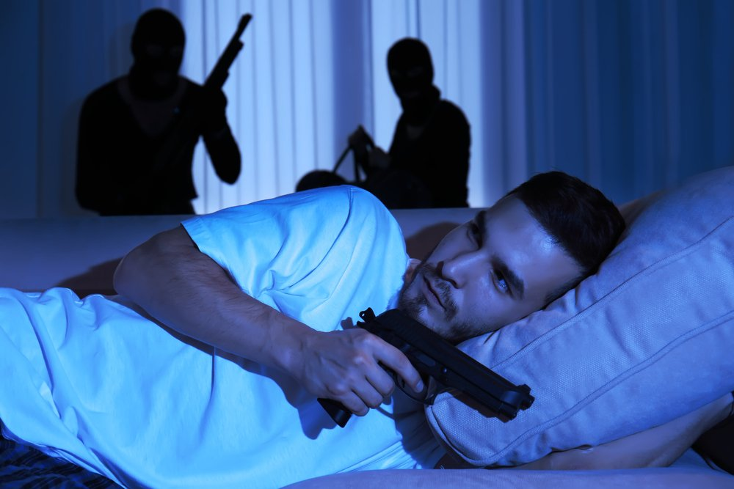
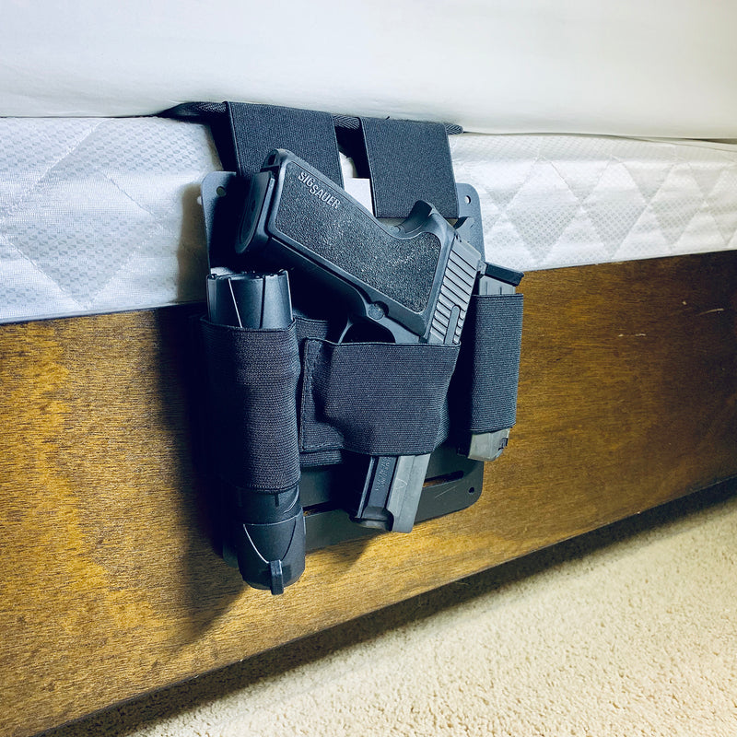
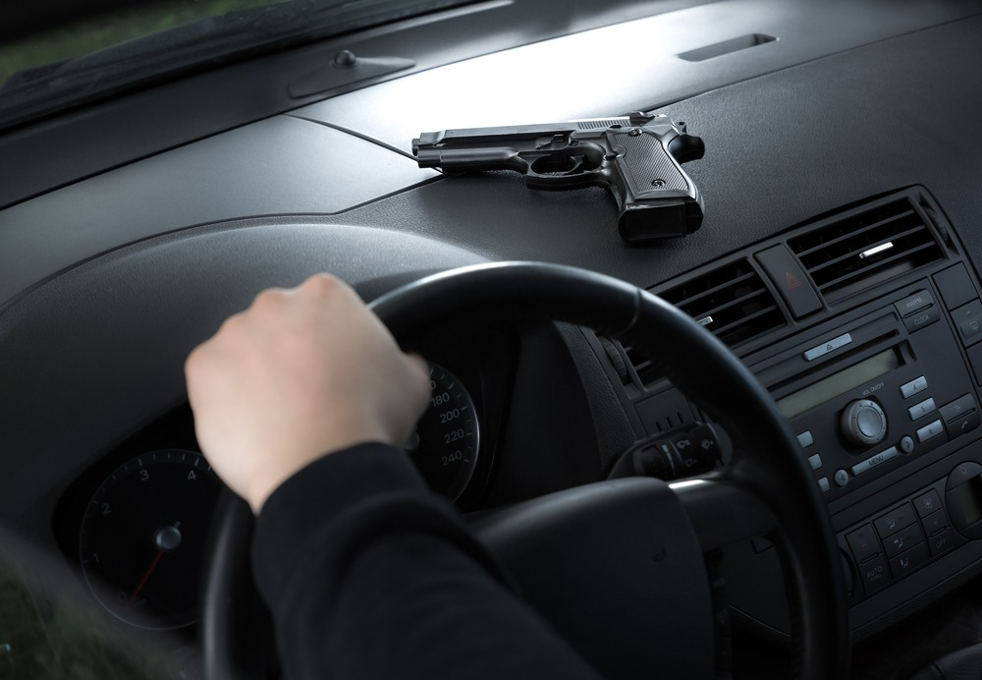
How do I safely store a firearm? Pt. 3
UNSAFE STORAGE
-Weird magnetic gimmicks
-Shoebox
-Dresser
-Under your pillow??
-Car
-Bedside holster

Slide 35
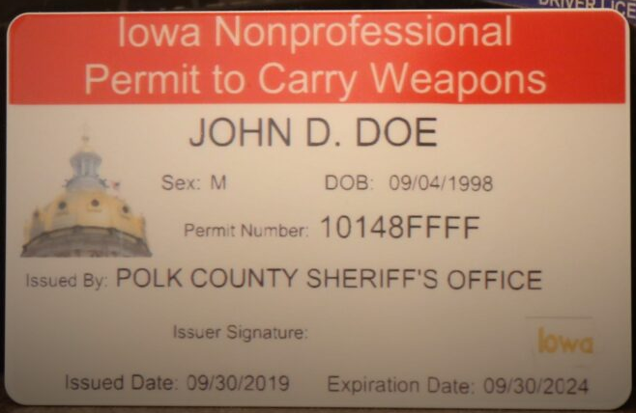
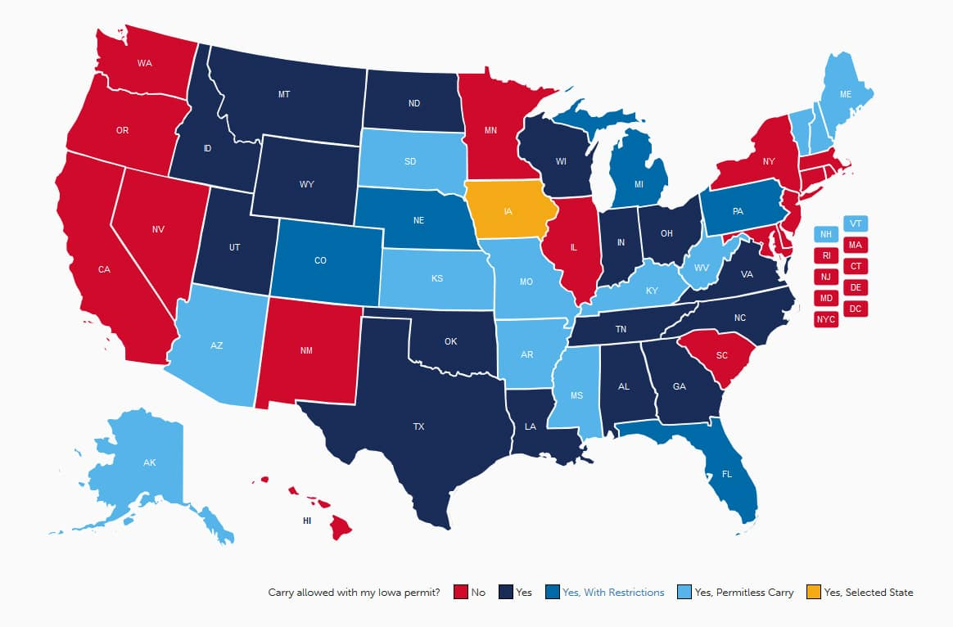
What is a Concealed Carry license?
A Permit to Carry is a document that communicates the legal privilege to carry a legal weapon concealed on your person.
Iowa does not require a permit to legally carry a concealed handgun, but a permit still has advantages.
A Nonprofessional Permit to Carry is issued by your county sheriff’s office.
dps.iowa.gov

Slide 36
How do I apply for a CCW permit?
Complete eligible training
Fill out an application (form W5)
Submit it to the sheriff’s office in your county of residence.
Iowa is a Shall Issue state. If you meet the legal criteria, you are entitled to a CCW license after paperwork is processed.
https://dps.iowa.gov/weapon-permit-applications

Slide 37
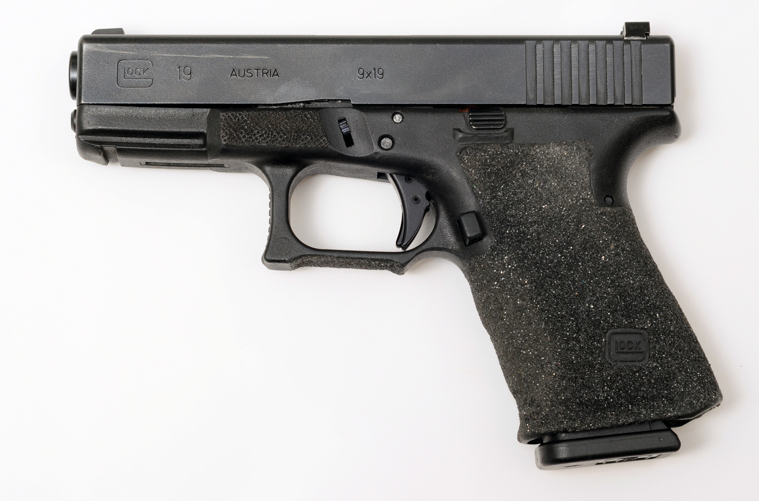
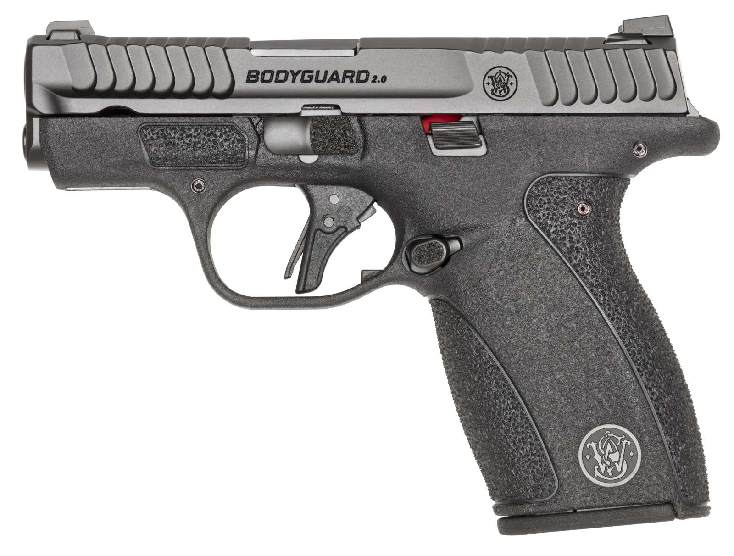
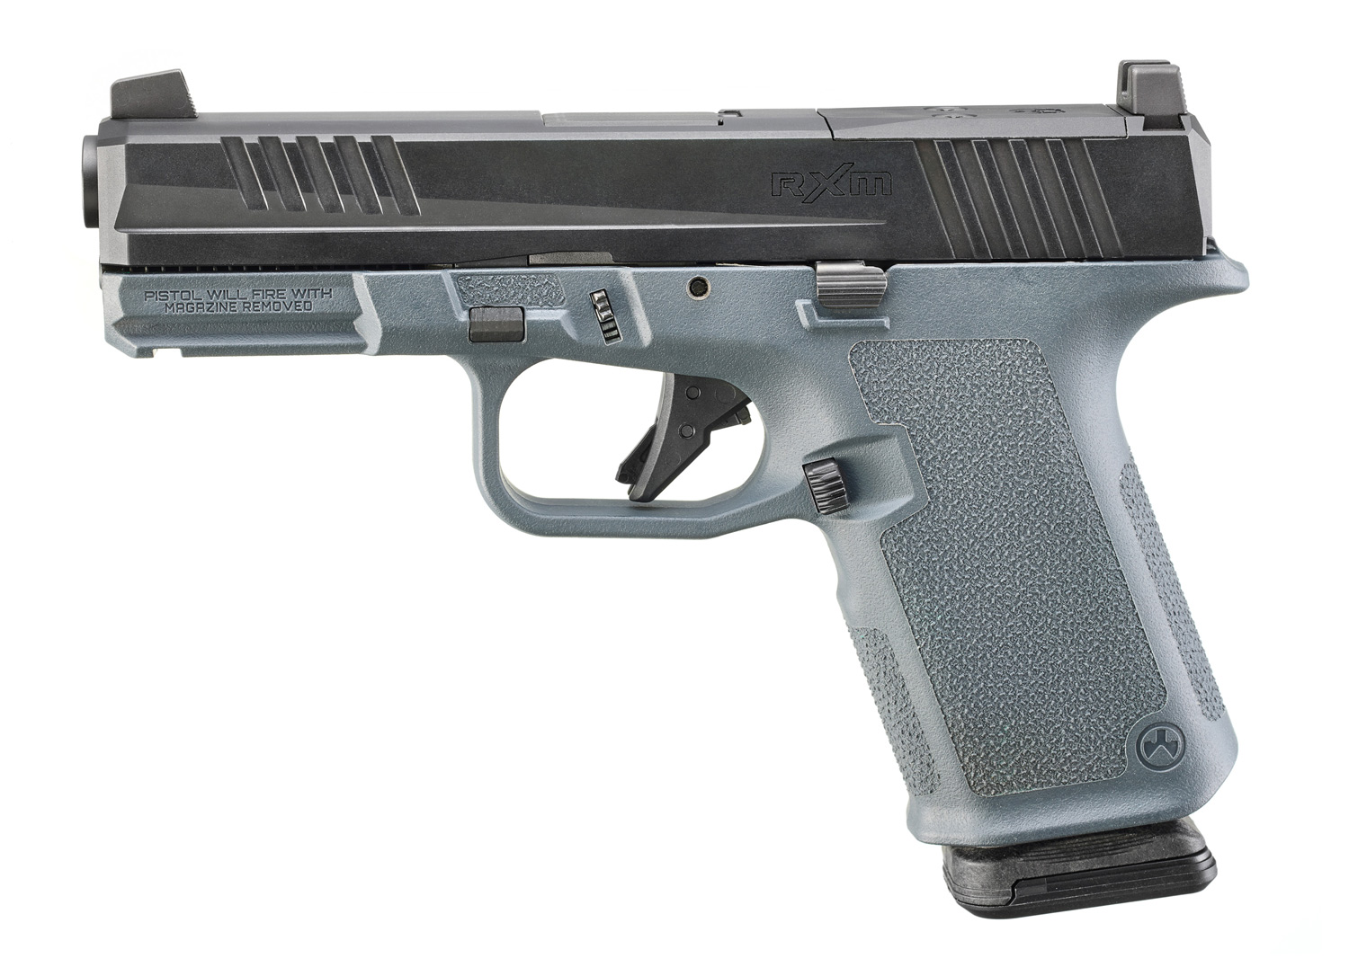
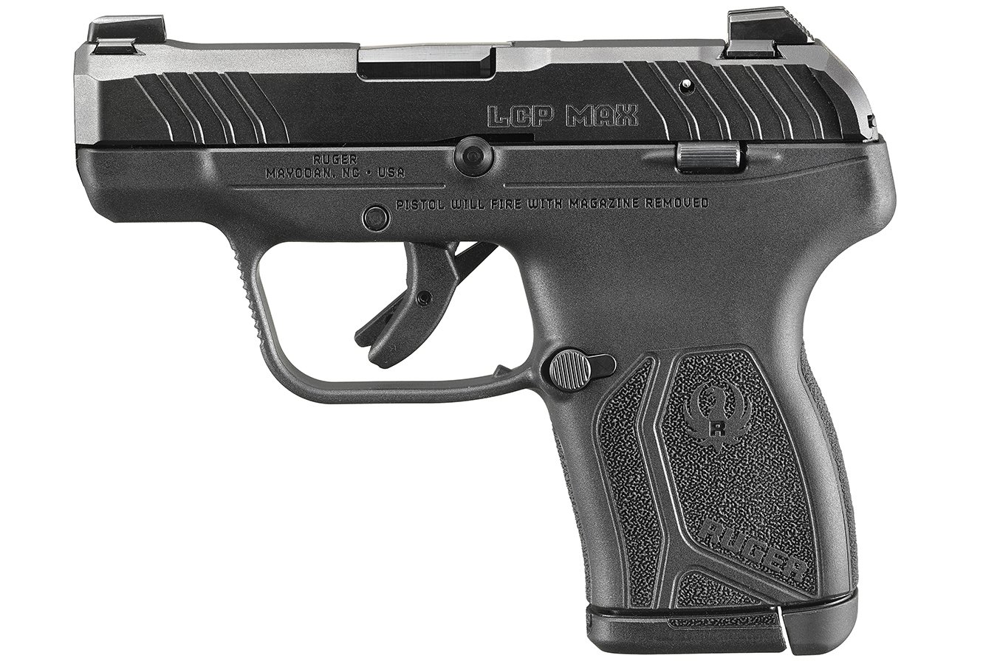
Standard choices for CCW handguns
9mm
.380acp
Glock 19
Original compact polymer striker fired handgun
MSRP $540
S&W Bodyguard 2.0
Compact striker pistol
MSRP $449
Ruger RXM
Glock 19 clone
MSRP $349
Ruger LCP Max
Subcompact / Pocket Pistol
MSRP $379
Sig P365
“Micro Compact” striker fired pistol
MSRP $669
Beretta 80x
Compact DA/SA pistol
MSRP $649

Slide 38
Concealing is easier and more complicated than you may think
Graphic via phlsterholsters.com

Slide 39
Spot the firearm! Is this man concealing a gun?
No! He is concealing a 12” cast iron frying pan.

Slide 40
Spot the firearm! Is this woman concealing a gun?
Emily Stanley
@princessandthepistol on IG
Yes! And she became a meme for a hot minute.

Slide 41
Sample daily carry setups
IWB Holster (In waistband)
OWB Holster (over waistband)
Off-Body Carry
Broadly speaking, a concealable, safe IWB holster is the better bet for most people.
Flashbang Bra Holster
Pocket Carry

Slide 42
Sample daily carry setups
Beretta 80x Cheetah
Holosun 407 Red Dot
PHLster Enigma Express
The PHLster Enigma can be pricey but opens up a lot of concealment possibility and we strongly recommend looking into it if you have the means.

Slide 43
How do I talk to my children about gun safety?
A little knowledge can be dangerous. We cannot control our kids’ whole info streams. It is incumbent that a parent or guardian be the first line of education for their children.
Useful Resources
Conversation
Best Practices
Be honest. Age- appropriate, but honest.
Make your expectations for safety very clear.
Emphasize heavily that it is never their job to touch any firearm, anywhere - unless under the direct instructional supervision of an adult.
If using keyed locks, do not retrieve your key or unlock your firearms while a child is present.
Make sure that any key or written combination is stored in a place that is inaccessible to children.
Start education young and remain consistent.

Slide 44
How do I learn how to shoot?
Take a class
Dryfire
Learn from friends
Try a competition

Slide 45
Learn to Shoot - Classes

Slide 46
Good resources for further learning
Tacticool Girlfriend - YouTube/Insta
Annette Evans - https://onherown.life &YouTube
Karl Kasarda - InRangeTV - YouTube
Tessah Booth - YouTube

Slide 47
Topics We Didn’t Have Time For…
Home Defense
Cleaning & Maintenance
Repair
Ammo Selection
Long Guns
Transport from Home
Malfunctions
Crime and Firearms
Community Defense
Flying with Firearms
Dry Fire Drills
Legal Concerns
Open Carry (Generally: don’t)
Shooting Range Etiquette
Live Fire Drills
NFA Firearms and Items
Vetting Trainers
Paper vs Steel Targets
Types of Actions
AR-15 Myths
First Aid / Stop the Bleed
Range Bag Basics
Gifting Firearms
…AND MORE

Slide 48
Question Time!

Slide 49
Surplus Slides - If Time Permits

Slide 50
Concealing is easier and more complicated than you may think

Slide 51
Concealing is easier and more complicated than you may think

Slide 52
How do I learn how to shoot? - Competition styles.
Handgun or PCC divisions
Mostly standing
Four repetitions of the same target presentation
Very low barrier to entry, often very casual.
Excellent for practicing fundamentals of target acquisition, transition, and trigger pull.
Steel Challenge

Slide 53
How do I learn how to shoot? - Competition styles.
Handgun or PCC divisions
Fast footwork is emphasized
Sometimes called “golf with guns” - competitors often use highly specialized handguns.
Good for fundamentals of moving and shooting
Extremely high skill ceiling.
USPSA

Slide 54
How do I learn how to shoot? - Competition styles.
Inclusive, high skill match format with a variety of divisions
“...combines tests of marksmanship, physical challenge, and brutal scoring.”
Higher barrier to entry (cost and travel)
Emphasis on dynamic, varied stages while stress-testing skills.
Brutality / 2 Gun Action

Slide 55
How to find a competition
[TBD - more 102 or 201 stuff if interested]
Practiscore
Local range calendars
Instructor help

